Slide 1
PIZZA SALES PERFORMANCE DASHBOARD (2015)
Domain: Business Analyst
Tool Used: Power BI
Dataset: Pizza Sales Transaction Dataset
Project Level: Intermediate
Description:
This project analyzes pizza sales performance using interactive Power BI dashboards. It focuses on revenue, order patterns, product performance, and operational efficiency to support data-driven business decisions for a restaurant.

Slide 2
PROBLEM STATEMENT
Restaurants collect transactional sales data daily, but without proper analysis, it is difficult to identify sales patterns, peak hours, and best-selling products.
Challenges Addressed:
Identifying peak business days and hours
Understanding best and worst-selling pizzas
Measuring average order value and order size
Evaluating seating utilization efficiency

Slide 3
PROJECT OBJECTIVES
Analyze total revenue, orders, and pizzas sold
Identify top and bottom-performing pizzas
Analyze sales by weekday, hour, size, and category
Measure operational metrics such as seating utilization
Provide interactive insights using Power BI dashboards

Slide 4
DATA PREPARATION (TECHNIQUES)
Steps Performed:
Imported pizza sales dataset into Power BI
Cleaned and validated transactional data
Created date and time attributes (Day, Month, Hour)
Verified numeric and categorical fields
Key Fields Used:
Order ID, Order Date, Order Time
Pizza Name, Category, Size
Quantity, Unit Price, Total Price
Purpose:
To ensure accurate, consistent, and reliable analysis.

Slide 5
CALCULATIONS & KPIs
Measures Created:
Total Revenue=SUM('Fact Table'[TotalPrice])
Total Orders=DISTINCTCOUNT('Fact Table'[OrderId])
Total Pizzas Sold=SUM('Fact Table'[Quantity])
Average Order Value=DIVIDE([Total Revenue], [Total Orders])
Average Pizzas per Order=DIVIDE([Total Pizzas Sold], [Total Orders])
Seating Utilization=DIVIDE([Estimated Customers], 60)
Example Calculation:
Purpose:
To convert raw sales data into meaningful business metrics.
Average Order Value = Total Revenue / Total Orders

Slide 6
VISUALIZATION TECHNIQUES
Visualization Techniques Used
KPI Cards for key metrics
Bar Charts for comparisons
Line Charts for trends
Donut Charts for category distribution
Matrix & Ranked Charts for top/bottom analysis
Interactivity:
Slicers (Pizza Category, Size, Month)
Drill-down analysis
Clear slicer button

Slide 7
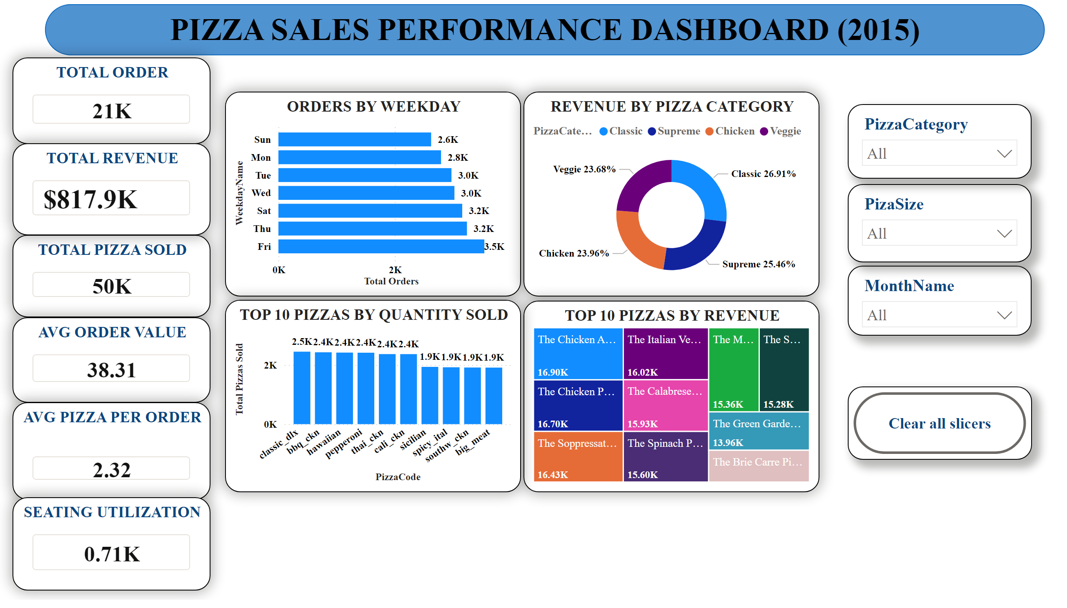
Dashboard Highlights:
Total Orders, Revenue, Pizzas Sold
Orders by weekday
Revenue by pizza category
Top pizzas by quantity and revenue
Purpose:
Enable quick, executive-level understanding of overall sales performance.

Slide 8
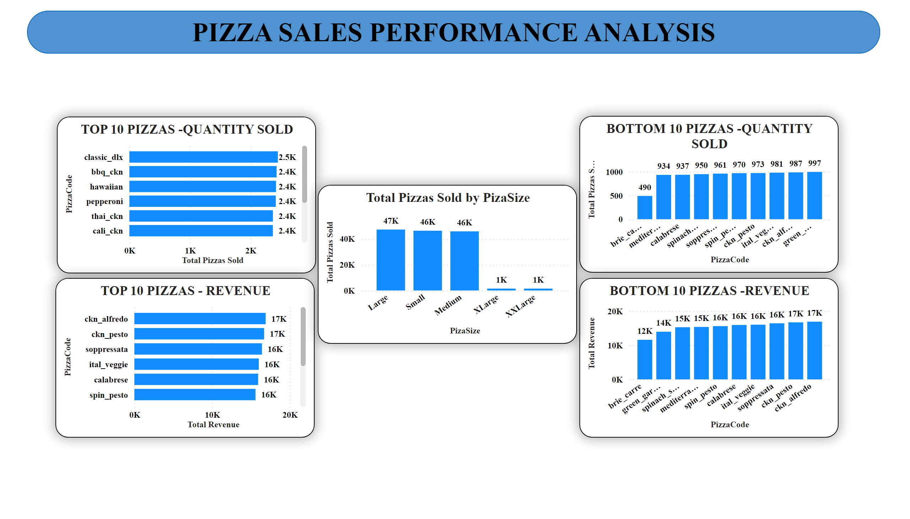
Insights:
Classic and Supreme categories contribute the highest revenue
Certain pizzas dominate both quantity sold and revenue
Bottom-selling pizzas have limited contribution to total sales
Pizza size significantly influences sales volume

Slide 9
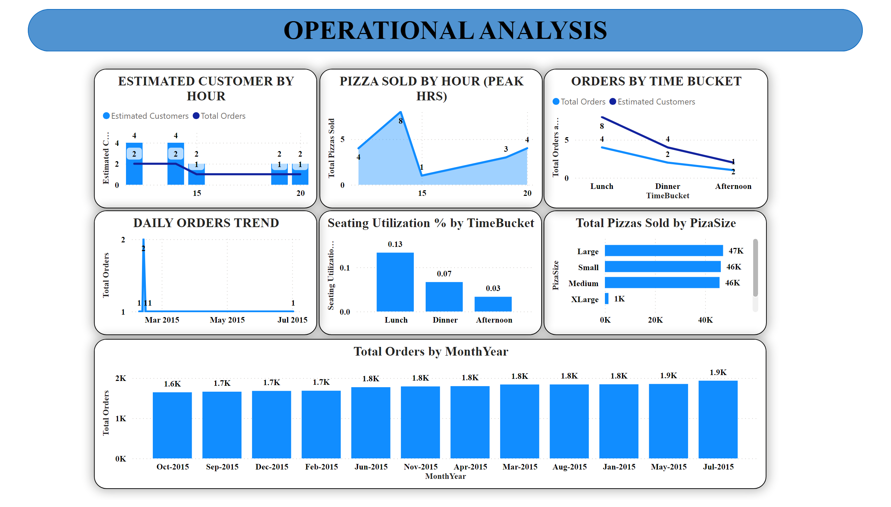
Operational Insights:
Peak orders occur during lunch and dinner hours
Fridays and weekends record the highest order volumes
Seating utilization is higher during lunch compared to afternoons
Monthly order trend remains relatively stable across the year

Slide 10
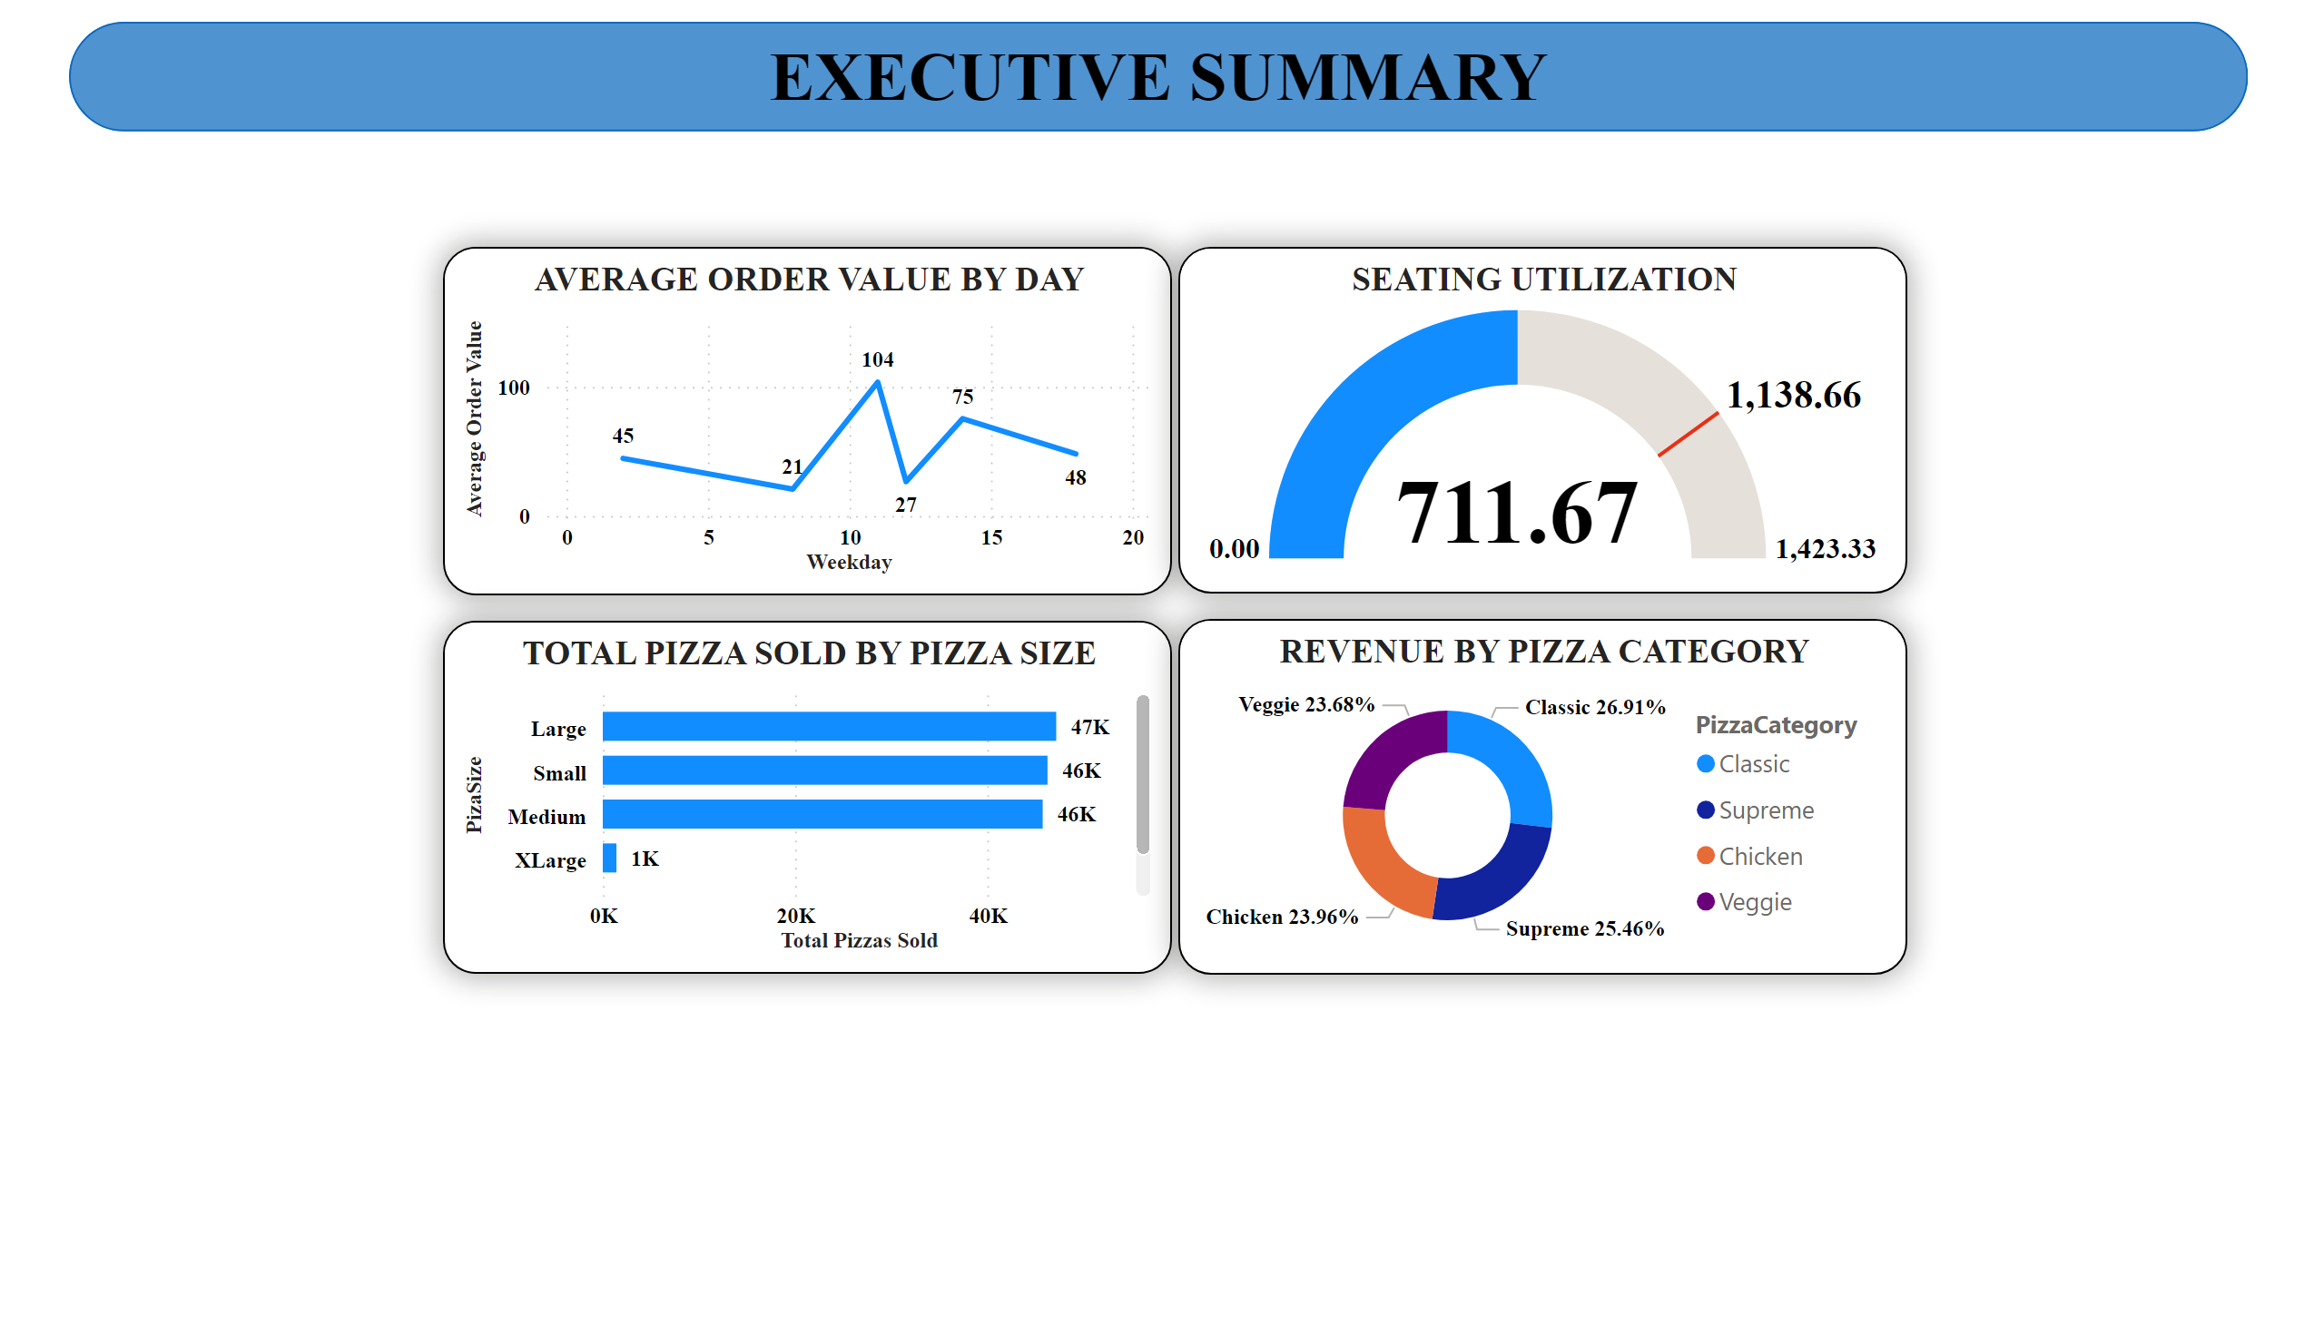
Executive Summary Insights
Average order value remains consistent across days
Large and Medium pizzas are the most sold sizes
Classic pizza category contributes the highest revenue share
Operational efficiency can be improved during non-peak hours

Slide 11
KEY FINDINGS
Key Findings
Fridays and weekends are the busiest periods
Classic pizzas are the best-selling category
A small number of pizzas contribute the majority of revenue
Seating capacity is underutilized during afternoon hours

Slide 12
CONCLUSION & FUTURE SCOPE
Conclusion
The Pizza Sales Dashboard successfully transforms transactional sales data into actionable insights. It helps restaurant management understand sales trends, customer behavior, and operational efficiency.
Future Enhancements
Demand forecasting for peak periods
Promotional impact analysis
Integration with real-time POS data
Advanced customer segmentation

